Slide 1
CSCI E-50 WEEK 3
TERESA LEE
teresa@cs50.net
FEBRUARY 12 2018

Slide 2
TODAY
Recap: arrays & debug50
asymptotic notation (O, Ω)
linear search
binary search
bubble sort
Selection sort
recursion
pset3

Slide 3
QUESTIONS?

Slide 4
ARRAY
To initialize an array
int score[0] = 0; // zero index all arrays! int score[1] = 1; int score[2] = 2;
or
int score[] = {0, 1, 2}; // size based on the number of entries
// make an array
<datatype> <name>[<size>];
char alpha[26];
Int score[5];
// iterate over the array’s members

Slide 5

STRING
Just an array of characters!
Final index of a string in C is the null terminator ‘\0’, which tells the system that the string is over.
// declare string
String s = “teresa”;
// what happens when I index into s[i]?
Printf(“%c\n”, s[0]);
Printf(“%c\n”, s[1]);
Printf(“%c\n”, s[6]);
Printf(“%c\n”, s[7]);

Slide 6
ARRAY
Adventages?
Constant-time acess given index
Space efficient
Aility to iterate through all elements
Disadvantages?
Elements of same type only
Fixed size!

Slide 7
Debug50
ex_debug.c

Slide 8
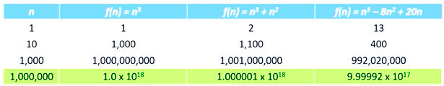
Computational Complexity
Complexity? Time & Space
Algorithm’s running time
O (upper bound)
Ω (lower bound)
Θ upper and lower bounds are the same
Notes:
Performance!
How to write good codes not just correct codes
What is algorithm?
Set of instructions for solving some problems.

Slide 9
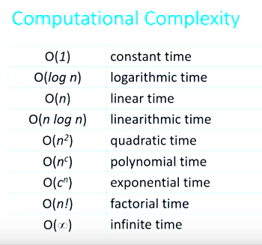
Computational Complexity

Slide 10
SEARCH

Slide 11

Linear search
O(n) , Ω(1)
// initialize an int array
Int haystack[] = {3, 2, 6}
// find the needle by using the linear search

Slide 12
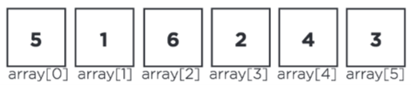
Let’s Look at an Example
Linear search:
What is the upper bound? O(n)
What is the lower bound? Ω(1)

Slide 13
Lenear Search
Find:
1
2
3
4
5
6
[0]
[1]
[2]
[3]
[4]
[5]
6

Slide 14
Let’s Look at an Example
Ex1_Linear

Slide 15
Binary search
O(log n), Ω(1)
Requirement? - sorted list!
//pseudocode for binary search

Slide 16
Binary Search
1
Find:
1
2
3
4
5
6
Start = 0
End = n-1
mid = (start+end) / 2
[0]
[1]
[2]
[3]
[4]
[5]

Slide 17
Let’s Look at an Example
Ex2_binary
What’s another way to perform this binary search?
recursion!

Slide 18
SORT

Slide 19
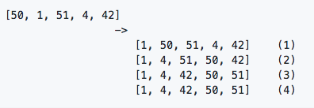
Selection Sort
In selection sort, the idea of the algorithm is to find the smallest unsorted element and add it to the end of the sorted list.
<pseudocode>
Repeat until no unsorted elements remain:
Search the unsorted part of the data to find the smallest value
Swap the smallest found value with the first element of the unsorted part
O(n²), Ω(n²)
Temporary variables?

Slide 20
Selection Sort
sorted
unsorted
6
5
4
3
2
1
Min
2
[0]
[1]
[2]
[3]
[4]
[5]
1
2
4
3
5
6
[0]
[1]
[2]
[3]
[4]
[5]

Slide 21
Let’s Look at an Example
ex3_selection

Slide 22
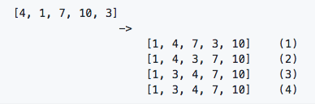
Bubble Sort
O(n²), Ω(n)
Pair-wise sorting
What variables do we need?
In bubble sort, the idea of the algorithm is to move higher valued elements generally towards the right and lower valued elements generally towards the left.
<pseudocode>
Set swap counter to a non-zero value
Repeat until the swap counter is 0:
Reset swap counter to 0
Look at each adjacent pair
If the two adjacent elements are not in order, swap them and increase the swap counter by 1.

Slide 23
Bubble Sort
6
5
4
3
2
1
[0]
[1]
[2]
[3]
[4]
[5]
Swap = 5
5
4
3
2
1
6
[0]
[1]
[2]
[3]
[4]
[5]

Slide 24
Let’s Look at an Example
1
2
3
4
5
6
Bubble Sort:
What is the lower bound? Ω(n)

Slide 25
Let’s Look at Example
6
5
4
3
2
1
Bubble Sort:
What is the upper bound? O(n^2)

Slide 26
Let’s Look at an Example
ex4_bubble

Slide 27
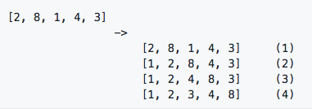
Insertion Sort
In insertion sort, the idea of the algorithm is to build your sorted array in place, shifting elements out of the way if necessary to make room as you go.
<pseudocode>
Call the first element of the array “sorted”
Repeat until all the elements are sorted:
Look at the next unsorted element. Insert into the “sorted” portion by shifting the requisite number of elements.
O(n²), Ω(n)

Slide 28
Insertion Sort
sorted
unsorted
6
5
4
3
2
1
[0]
[1]
[2]
[3]
[4]
[5]
5
6
4
3
2
1
[0]
[1]
[2]
[3]
[4]
[5]
4
5
6
3
2
1
[0]
[1]
[2]
[3]
[4]
[5]

Slide 29
Let’s Look at an Example
ex5_insertion

Slide 30
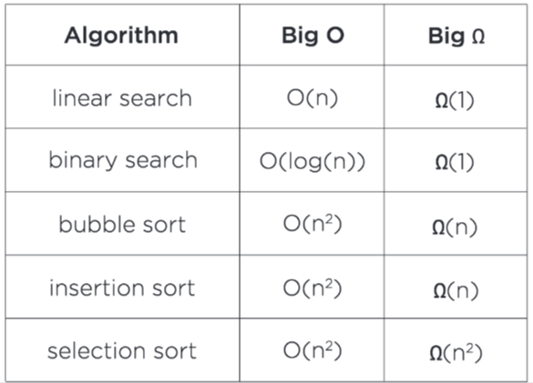
Running Time Summary

Slide 31
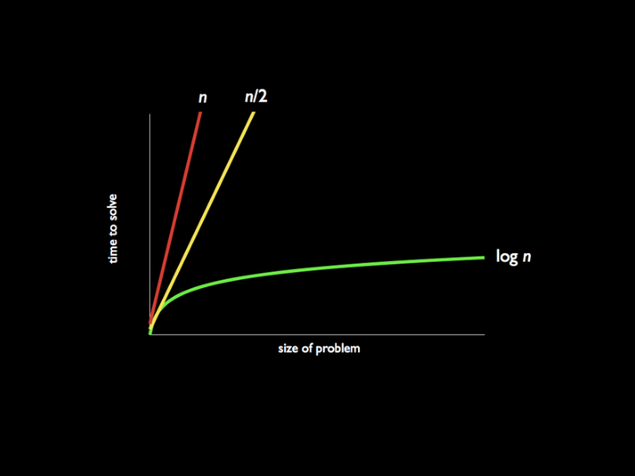
Running Time Summary

Slide 32
Recursion
Recursive function calls itself as part of execution
Cyclical use of a function
Every time you make a recursive call, there is a new stack frame
You need:
Base case: when triggered, terminates the recursive process
Recursive case: where recursive process will actually occur

Slide 33
Let’s Look at an Example
factorial(1) | 1
factorial(2) | 2 * 1 = 2
factorial(3) | 3 * fact (2)
factorial(4) | 4 * 3 * 2 * 1 = 4 * fact (3) = 24
factorial(5) | 5 * 4 * 3 * 2 * 1 = 5 * fact (4) = 120
factorial(n) | n * factorial(n-1) for all n >= 1

Slide 34
Let’s Look at an Example - Itervative Factorial
int fact2(int n)
{
int product = 1;
while (n > 0)
{
product *= n;
N--;
}
return product;
}

Slide 35
int fact(int n)
{
// Base case
// Recursive case
}

Slide 36
int fact(int n)
{
if (n == 1)
{
return 1;
}
else
{
return n * fact(n - 1);
}
}

Slide 37
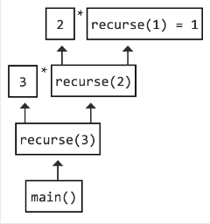
Let’s Look at an Example
Downside?
It can be memory-intensive!
While a recursive algorithm is not always required, it frequently looks much more beautiful and (though recursion is not itself a simple concept), a recursive implementation usually looks much simpler once coded.
fact
fact
fact

Slide 38
Let’s Look at an Example
ex6_recursion

Slide 39
pset3
Music

Slide 40
Shorts to Watch
Computational Complexity
Selection Sort
Bubble Sort
Insertion Sort
Linear Search
Binary Search
Algorithms Summary
Debugging
Recursion

Slide 41
Final words on pset3
Read background
Read specification
Watch Brian’s walkthrough
Remember to comment your codes!
Style Guide
Test with check50!

